Slide 1
Learning, Motivation & Emotion
Randall C. O’Reilly

Slide 2
Learning <- Motivation <- Emotion
Learning is the most important feature of the human brain: we learn almost everything!
Happens in synapses everywhere
Powers current deep AI models
Motivation drives what we learn
Intrinsic motivation most powerful: goals!
Emotion drives Motivation, Learning
Dopamine drives learning in basal ganglia
Classical / Instrumental conditioning

Slide 3
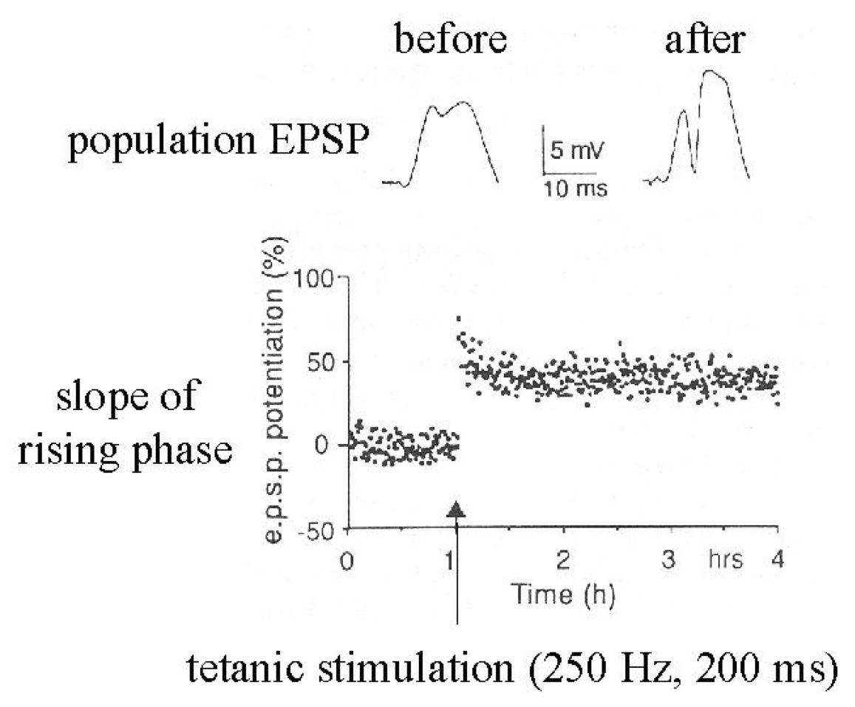
Synapses Change Strength (in response to patterns of activity)

Slide 4
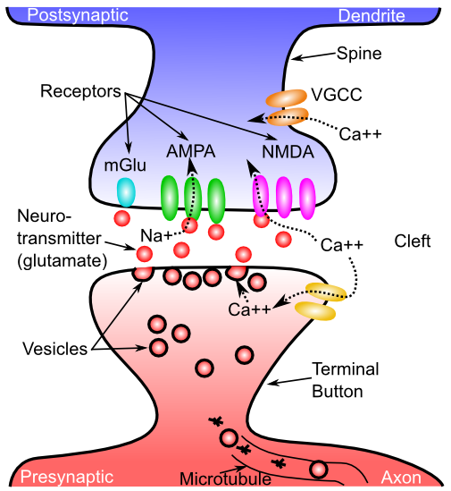
What Changes??

Slide 5
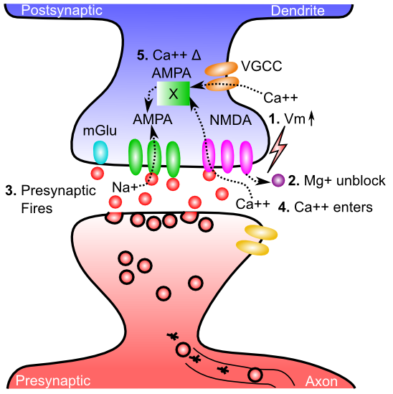
Gettin’ AMPA’d

Slide 6
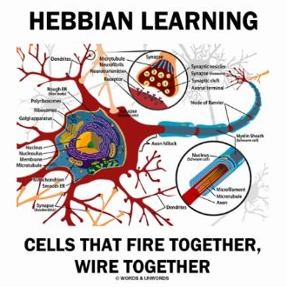

Slide 7
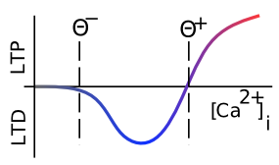
Which Way?
Low Ca = “long term depression” – synapse gets weaker
High Ca = “long term potentiation” – synapse gets stronger

Slide 8
Neocortical Learning
What works:
error backpropagation
Not biological: error goes opposite direction from spikes
Not psychological (where is that hand when you need it!?)

Slide 9
Key idea: We learn by constantly generating hypotheses or predictions about what will happen next!
Error = outcome - prediction

Slide 10
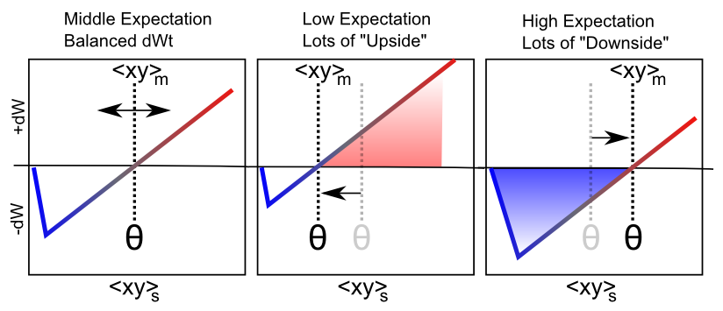
Dynamic Ca²⁺ Curve = Error
dW = Outcome – Prediction = <xy>_{s} - <xy>_{m}

Slide 11
Bidirectional Connections Propagate Error
Math! It works!

Slide 12
Summary of Neocortical Learning
Error Backpropagation works
Bidirectional connections communicate error
Dynamic Ca²⁺ curve: synapses learn from error
Predictive learning: constant source of error
(and Thalamus has circuits that could do it!)

Slide 13
Learning Rules Across the Brain
Area | Reward | Error | Self Org
Primitive Basal Ganglia | +++ | - - - | - - -
Cerebellum | - - - | +++ | - - -
Advanced Hippocampus | + | + | +++
Neocortex | ++ | +++ | ++
Learning Signal
+ = has to some extent … +++ = defining characteristic – definitely has
- = not likely to have … - - - = definitely does not have

Slide 14
Learning happens where it’s used (memory => processing)
Basal ganglia: learning what actions (not) to use
- based on reward / punishment (operant)
Cerebellum: learning to perfect actions
- based on error signals (e.g., feeling awkward)
Neocortex: learning how to see, hear, speak, reach, act, socialize… everything!
Hippocampus: learning snapshots of everything (explicit, declarative learning in Hippo, Cortex)

Slide 15
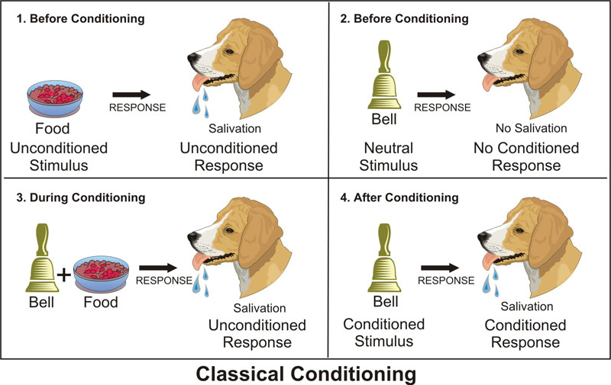
Classical Conditioning
US
UCR
CS
CR
CS associated with US, thinking of US drives CR

Slide 16
“Real World” Conditioning
The Office: https://vimeo.com/35754924

Slide 17
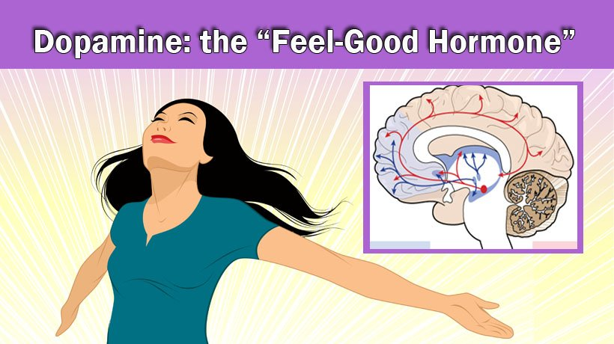
Dopamine Drives Conditioning
Neuromodulator

Slide 18
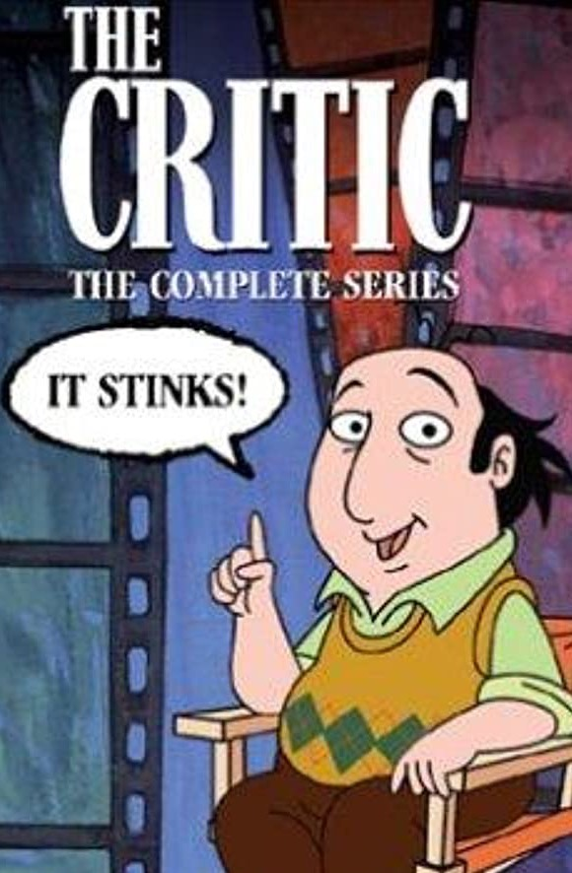
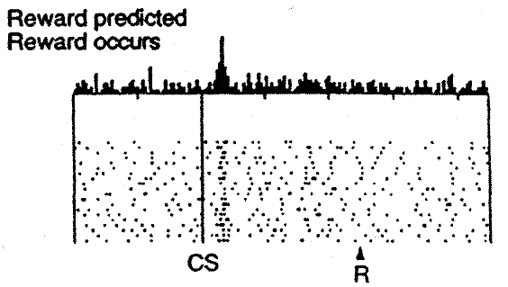
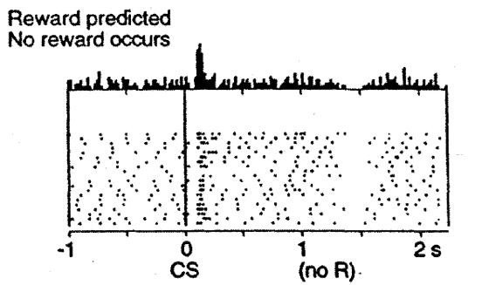

Dopamine is a Nasty Critic!

Slide 19
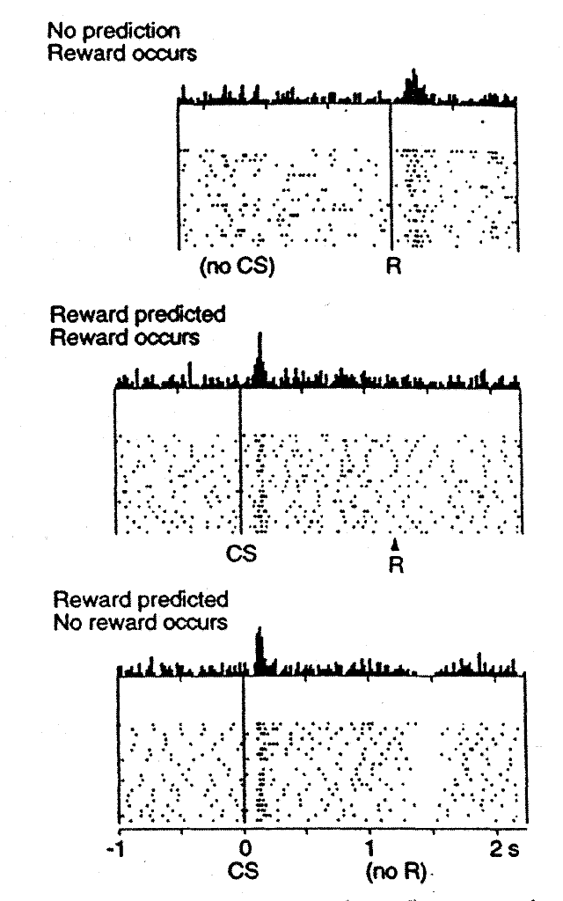
Reinforcement Learning: Dopamine
CS = Tone
R = Juice drop
Classical conditioning happens in dopamine

Slide 20
Dopamine Lessons
Dopamine = Outcome – Expectation
Should you just always have low expectations, so even low outcomes seem good??
I try hard to avoid hearing anything about movies

Slide 21
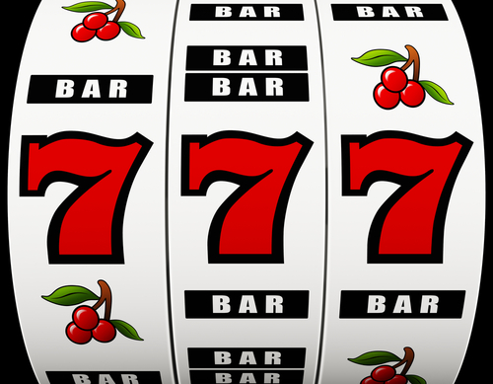
Partial Reinforcement!
Keeping your dopamine in the zone..
Dopamine learns
to expect anything
reliable and “cancels”
it out

Slide 22
Acquisition & Extinction
Acquisition: initial learning of CS -> US Assoc
Second order: CS1 -> CS2 -> US
Extinction: learning that CS !-> US anymore
This is NEW learning, not UN-learning!
Context-specific exceptions to prior learning
Spontaneous recovery of extinguished learning
Renewal: Learn in A, extinguish in B, A -> renewed
Reinstatement: expose to US, CS -> US reinst.

Slide 23
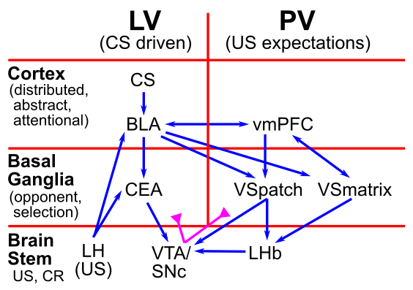
Biology of Classical Conditioning

Slide 24
Limits of Classical Conditioning
Biological Preparedness: built-in pathways for CS’s and US’s
Food can cause nausea, lights / tones shock, but not the other way around!

Slide 25
Operant / Instrumental Conditioning
Thorndike’s Law of Effect:
Actions -> Good stuff are “stamped in”
Actions -> Bad stuff are “stamped out”
Dopamine = Good (bursts) vs. Bad (dips/pauses) drives learning in Basal Ganglia in accord with Law of Effect!

Slide 26
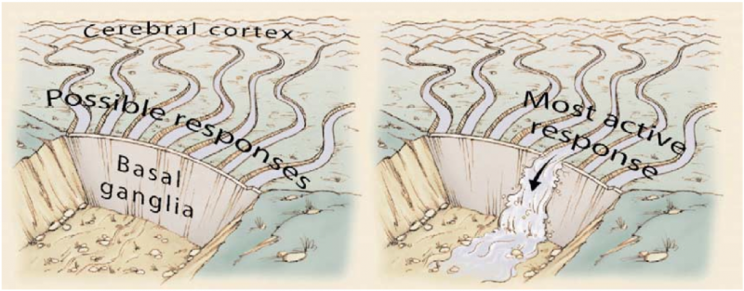
Basal Ganglia and Action Selection

Slide 27
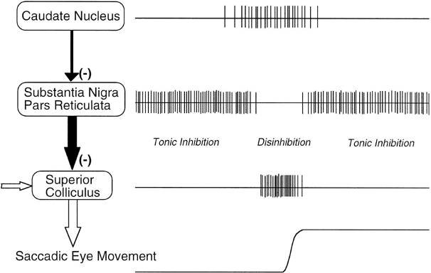
Release from Inhibition

Slide 28
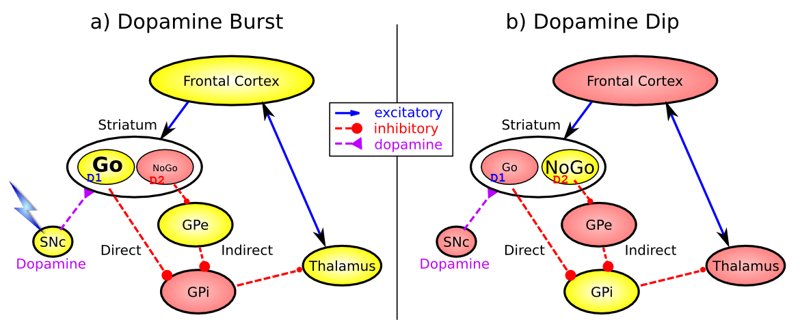
Basal Ganglia Operant Learning (Frank, 2005…; O’Reilly & Frank 2006)
Dopamine burst = do more of what you just did (Law of Effect)
Dopamine dip = do less of what you just did (bad outcome!)
-> Classical conditioning drives operant conditioning!!

Slide 29
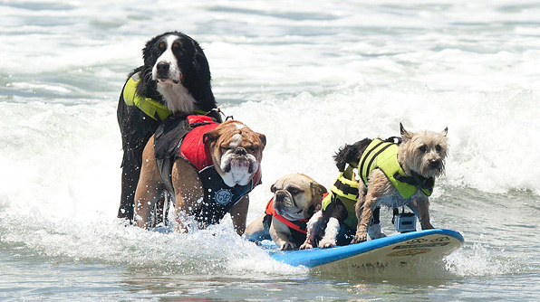
Operant Tricks
Secondary Reinforcer (e.g., $$): something associated with actual Primary Reinforcer
Shaping (by successive approximation) – it’s
how you get here:

Slide 30
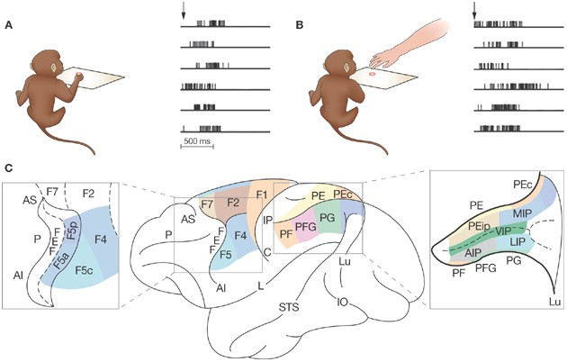
Imitation Learning, Mirror Neurons
Innate, animal imitation very limited
Does this mean when we watch violent media, we act more violent??

Slide 31
Motivation
Behaviorism is all about external motivation
Reward / punishment
People are all about internal motivation: goals!

Slide 32
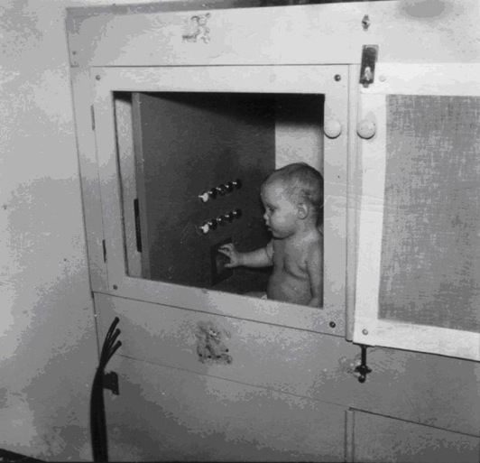
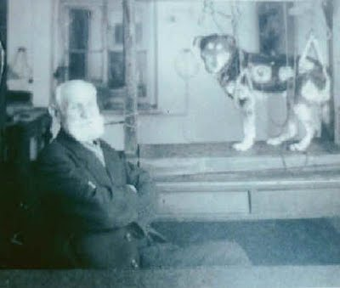
Behaviorist Motivations: Get rewards, avoid punishments..
Pavlov
Skinner
All extrinsic
Dopamine

Slide 33
Drives
Drive: desire to reduce unpleasant state from need (drive reduction theory: Hull, 1943)
Homeostasis: maintain target levels of blood sugar, water, etc. Drive = restore target level.
Maintain optimal arousal level? Not everything is a drive..
Need
(food, water..)
Drive
(hunger, thirst)
Drive-reducing behaviors
(eat, drink)

Slide 34
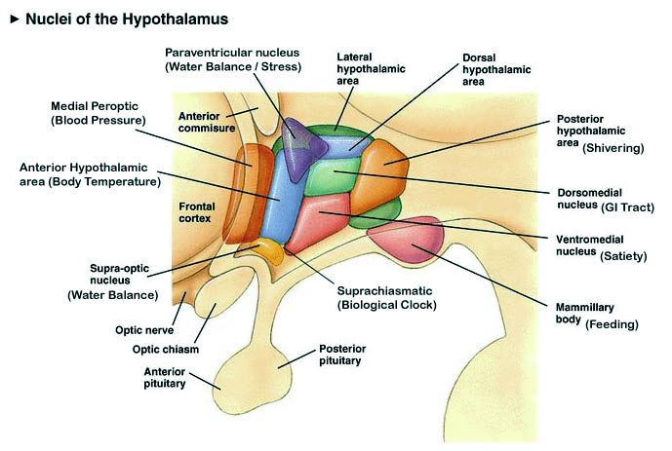
Basic Drives: Hypothalamus

Slide 35
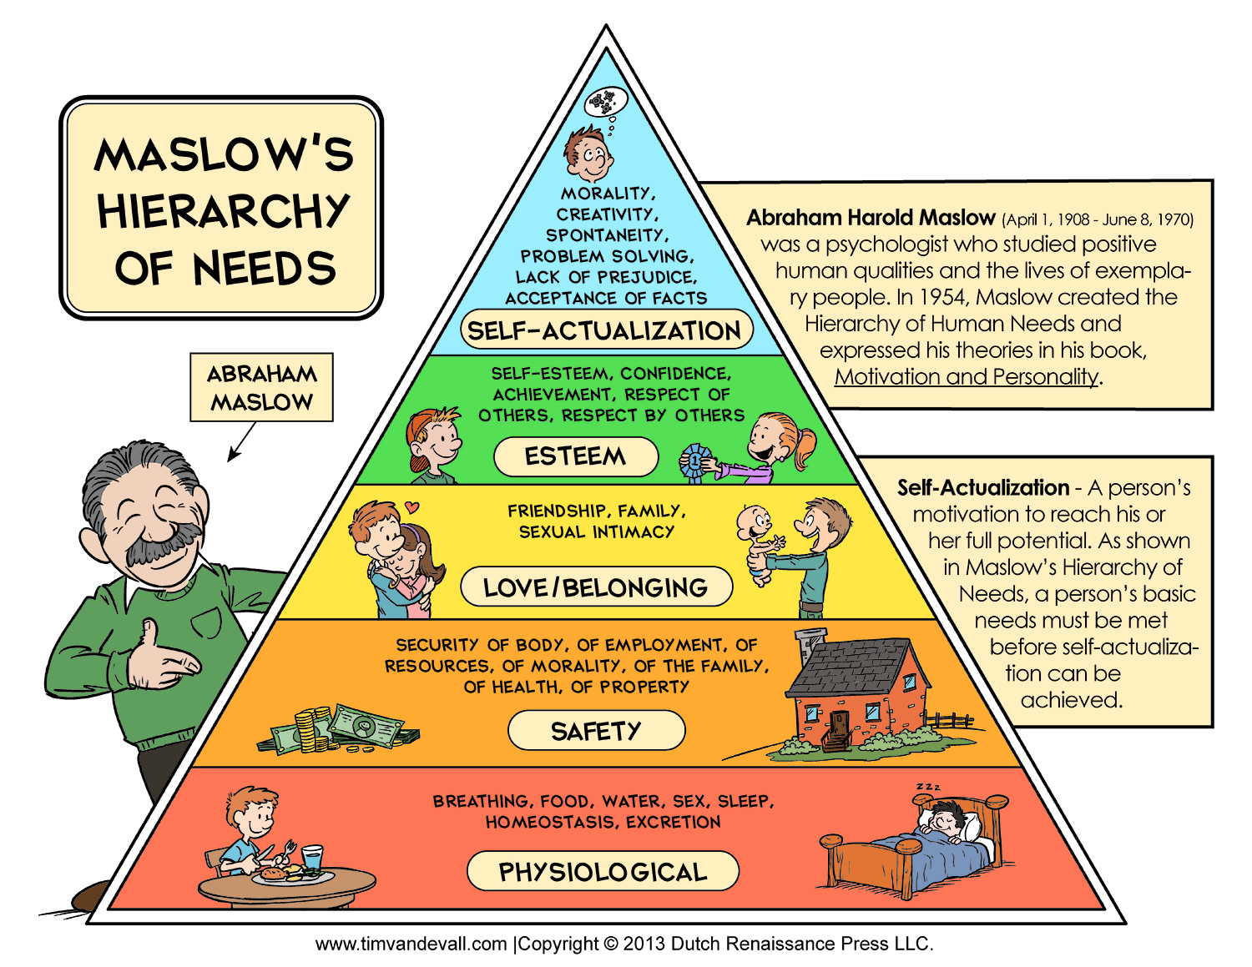
Needs

Slide 36
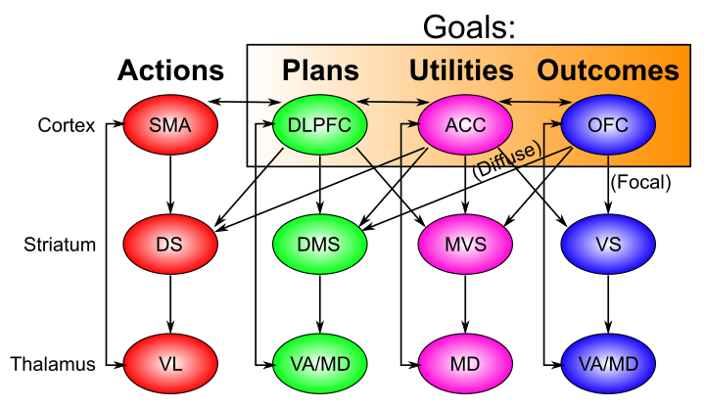
Distributed Goal Network
Striatum: helps select, maintain coordinated reps throughout network (BG gated WM)

Slide 37
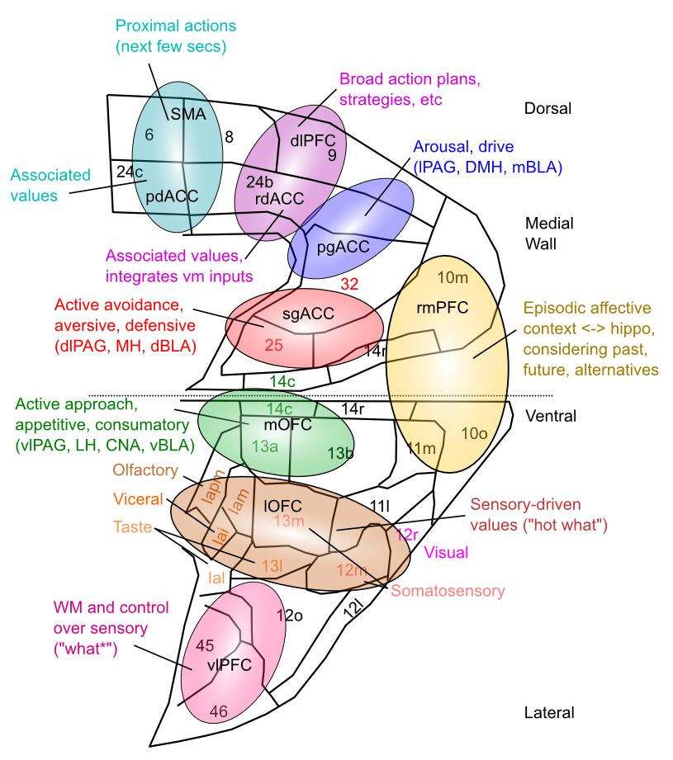
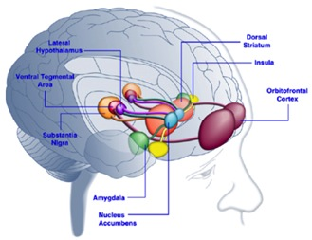
Map of Goals in vmPFC
Driven by subcortical connectivity
High-dimensional, multi-factorial representation
Consistent with fMRI, MDD in sgACC, etc

Slide 38
Extrinsic undermines Intrinsic?
Providing extrinsic rewards undermines intrinsic motivation!
- e.g., rewarding kids for homework?
Emphasizing trait makes people nervous
- “you’re so smart” vs. “you worked hard!”

Slide 39
Motivating Phenomenology
Why is it so hard to start something (packing for a trip, writing a paper, paying bills, cleaning desk…)
But once started, it really isn’t so bad..

Slide 40
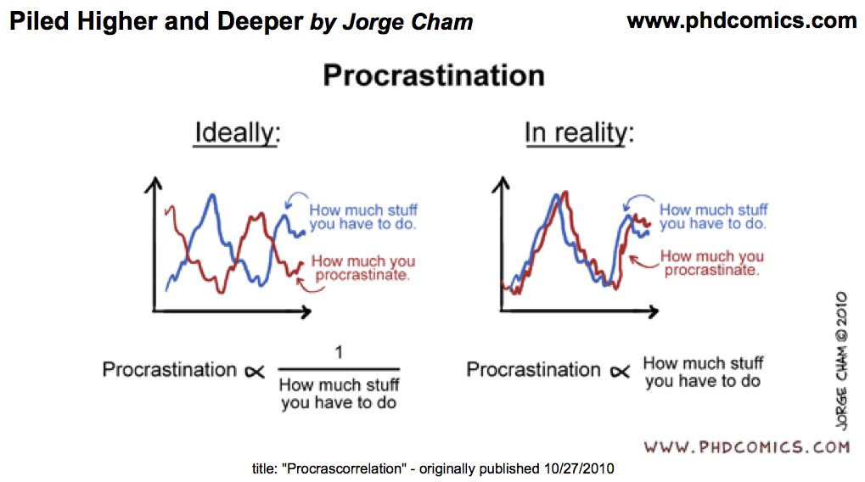

Slide 41
Motivating Phenomenology
Ever find yourself playing mindless video games for far longer than you should?
Why can’t I stop myself from organizing my kid’s Legos, or cleaning leaves from pool?

Slide 42
Two Phases of Mental Life
Goal selection
Careful weighing of costs / benefits to select goal
Multiple constraint satisfaction of needs, “drives”, opportunities, risks, costs, effort, etc..
Goal engaged
Selected goal robustly held – hard to give up..
Continuous evaluation of proximity to goal
Dopamine bursts, dips as function of changes
Costs are significantly downplayed (but learned)
Strong dissociations in value functions

Slide 43
Applied to Phenomenology
Why is it so hard to start something (packing for a trip, writing a paper, paying bills, cleaning desk…)
But once started, it really isn’t so bad..
Goal selection process carefully weighs costs / benefits, considering many different possible goals

Slide 44
Applied to Phenomenology
Ever find yourself playing mindless video games for far longer than you should?
Why can’t I stop myself from organizing my kid’s Legos, or cleaning leaves from pool?
Goal is engaged: incremental progress drives dopamine – video games engineered to deliver
Costs, alternatives are downplayed

Slide 45
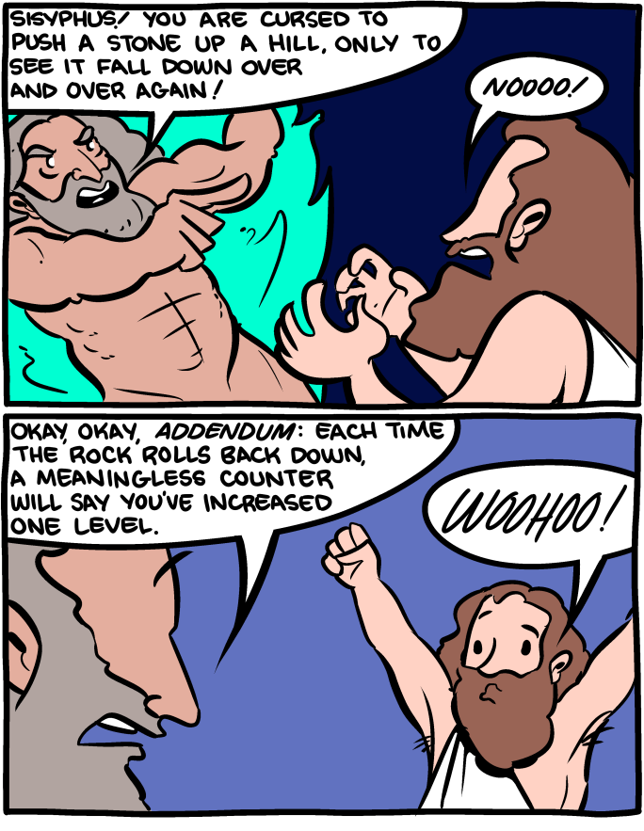

Slide 46
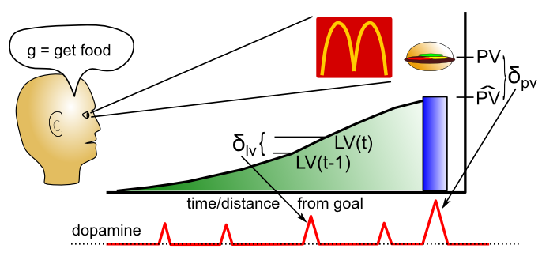
Dopamine = progress toward goal
LV = phasic dopamine driven by engaged goal
PV = was goal achieved or not; time to select new

Slide 47
Approach vs. Avoid
Approach = left hemisphere = dominant
Avoid = right hemisphere = subordinate
We approach positive outcomes, and avoid negative ones.
Anger is negative: is it approach or avoid?
Need to turn negative into a positive in order to act!

Slide 48
Work Motivation
If motivation is purely homeostatic, why are so many people motivated to work?
Extreme: workaholic (esp USA, Japan)

Slide 49
Work Motivation
Industrial and Organizational Psychology (I/O)
Traits: stable personality factors – conscientious, honest, lazy, aggressive, sociable, shy, etc..
Workaholic: neuroticism, perfectionism, conscientiousness
Perceived self efficacy: If we are good at something, we reinforce that, it becomes part of our self-image.. CCC = Control! (competence)
Goal-setting theory: specific and difficult goals are good for motivating employees..

Slide 50
Challenge Problem: Grad School
Grad students work long hours for little $ and a low-probability shot at becoming a professor.. Why?

Slide 51
Social Motivation
Need to Affiliate: we like to have people around (at parties and speeches, but not at beaches..)
Women affiliate under stress, men do opposite
Need to Belong: positive mutual in-group interactions of an enduring nature: key factor in overall happiness.
Loneliness: not as much belonging as wanted
Intimacy: self-disclosure, partner responsiveness

Slide 52
The Motivational Perfect Storm
Imagine something that taps directly into multiple built-in motivational pathways simultaneously.. Something so powerful that it:
Leverages strong social drives for belonging, affiliation, in-group promotion, out-group aggression
Provides frequent, unpredictable bits of “progress” in flow of news, funny, entertaining information, etc..

Slide 53
Emotion
Emotion is short lived psychological state that:
Activates specific emotional neural systems
(amygdala, ventral striatum, ventral-medial PFC)
Has characteristic subjective feeling
Triggers physiological changes (heart rate etc)
Also cognitive changes (thinking is altered)
And behavioral responses (behavior is affected)
Mood is long lasting, less intense, not triggered
Affect is simple “map” for categorizing emotions
valence (good / bad)
arousal (high / low)

Slide 54
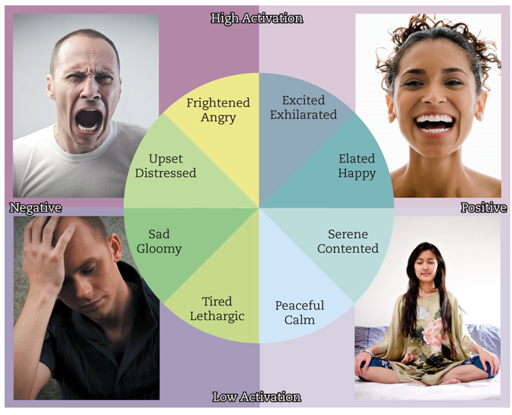
Valence vs. Arousal

Slide 55
Basic Emotions
Fear, Anger, Sadness, Happiness, Disgust, Contempt, Surprise/Interest
Why are these basic? What causes them? What benefits do they provide? Why only 1 positive?
Where are Love and Hate?
Why not Pain? Hunger? Lust?

Slide 56
The Face of Emotion
These facial expressions are universal.
What are they!?

Slide 57
News Flash: “Not” Face Discovered!
C. F. Benitez-Quiroza, R. B. Wilburb, A. M. Martinez (2016), Cognition, 150, 77-84

Slide 58
Emotion for Communication
It is important to communicate emotion – hence facial expressions.. And emoticons :)
Display rules are cultural conventions about when and how to display emotions: intensify, de-intensify, mask, neutralize

Slide 59
Emotion -> Motivation
Emotions drive motivation, learning: without them everything is neutral and you can never decide!
Fear: avoid bad things; Anger: attack bad things
Disgust: don’t eat rotten things
Contempt: punish bad people
Happiness: approach, enjoy good things
Surprise/interest: learn about unexpected things
What is the point of Sadness!?

Slide 60
The emotional brain

Slide 61
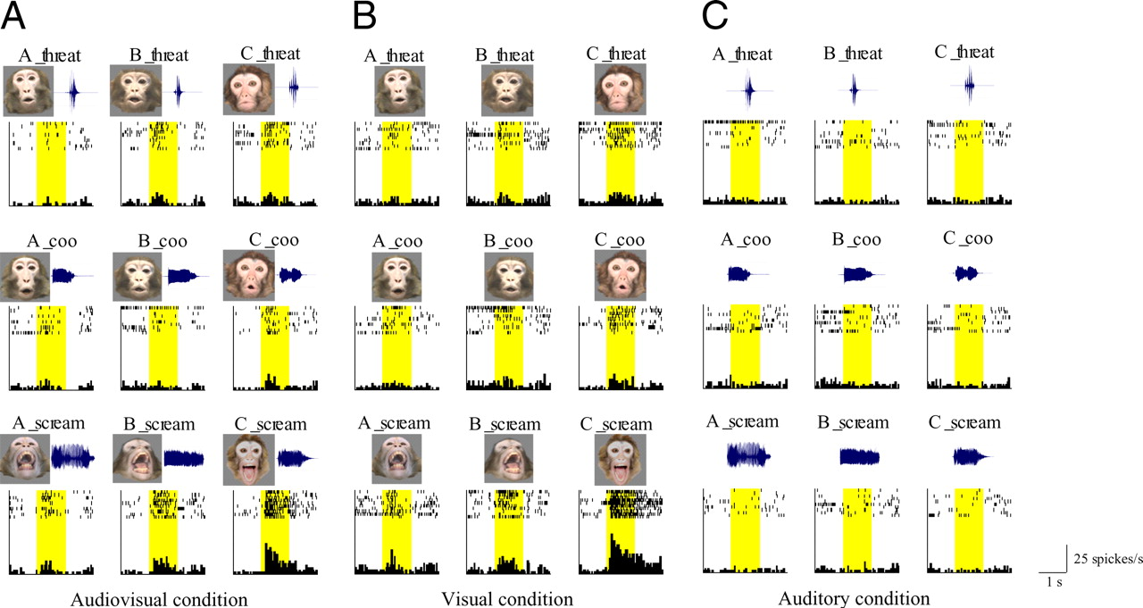
Amygdala Encodes Different Emotions

Slide 62
Negative Emotions
Happy families are all alike; every unhappy family is unhappy in its own way.
- Leo Tolstoy, Anna Karenina
We have many more negative emotions than positive ones!
So we should learn to accept this fact!

Slide 63
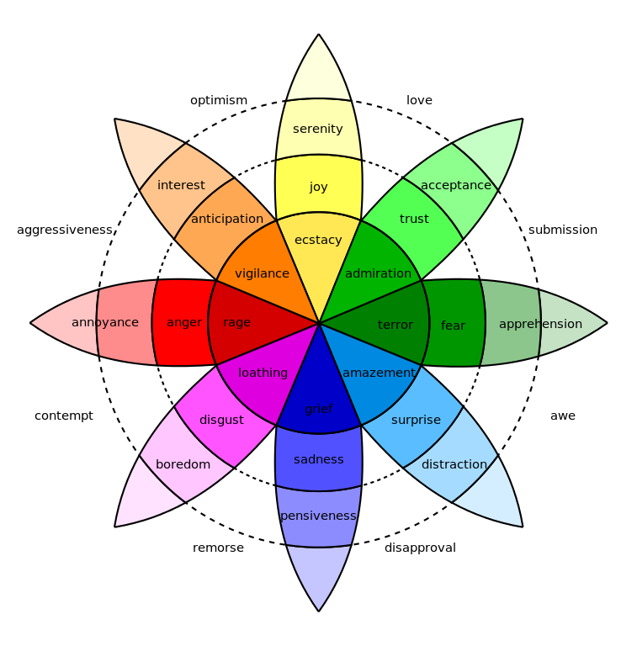
Robert Plutchik

Slide 64
The Two Faces of Happiness
Happiness = instantaneous emotional feeling
Happiness = long-term life satisfaction
Good news: everybody’s happy-ish!
Bad news: some people aren’t!
Parents are low on instantaneous, high on long-term..

Slide 65
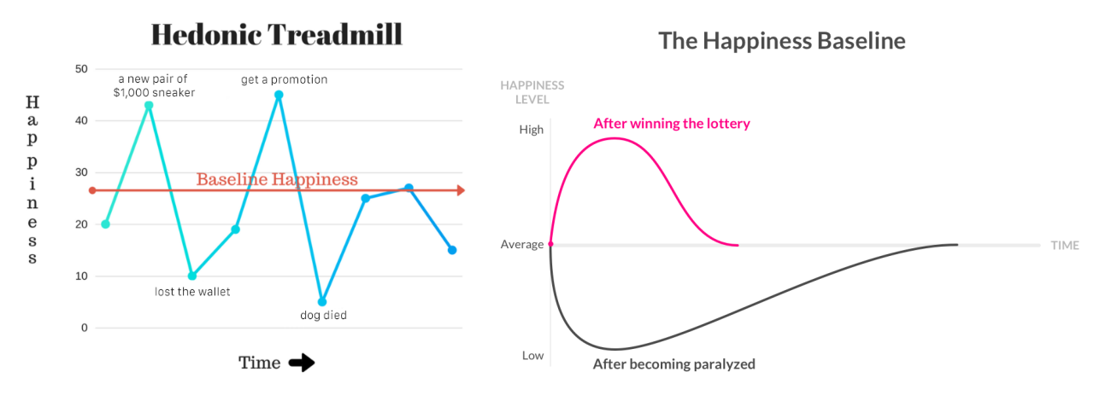
Surprise!?

Slide 66
Money != Happiness
Above ~$75, more $ != more happiness
So what does = more happiness?
Immediate social network, relationships
Standing in community / social recognition
Goal achievement
Dopamine driven by social feedback and progress toward goals!!!
And a major (50%) contribution of genes..

Slide 67
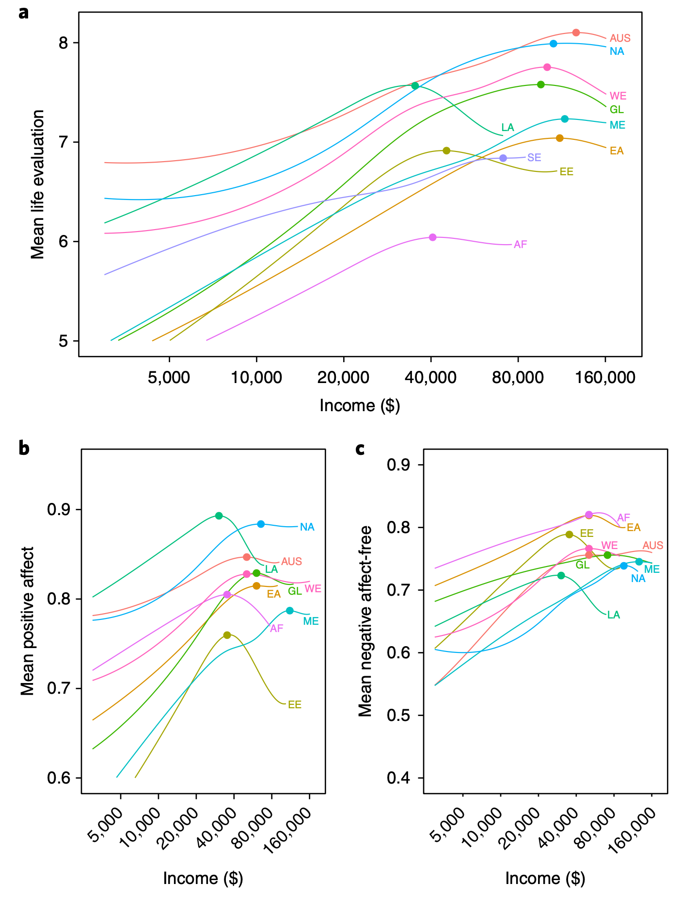
Jebb et al, 2018

Slide 68
Anger is not a liquid
You don’t have to vent it! Leads to rehearsal..
Figure out the underlying source of frustration
Deal with it
And / or learn to accept the situation

Slide 69
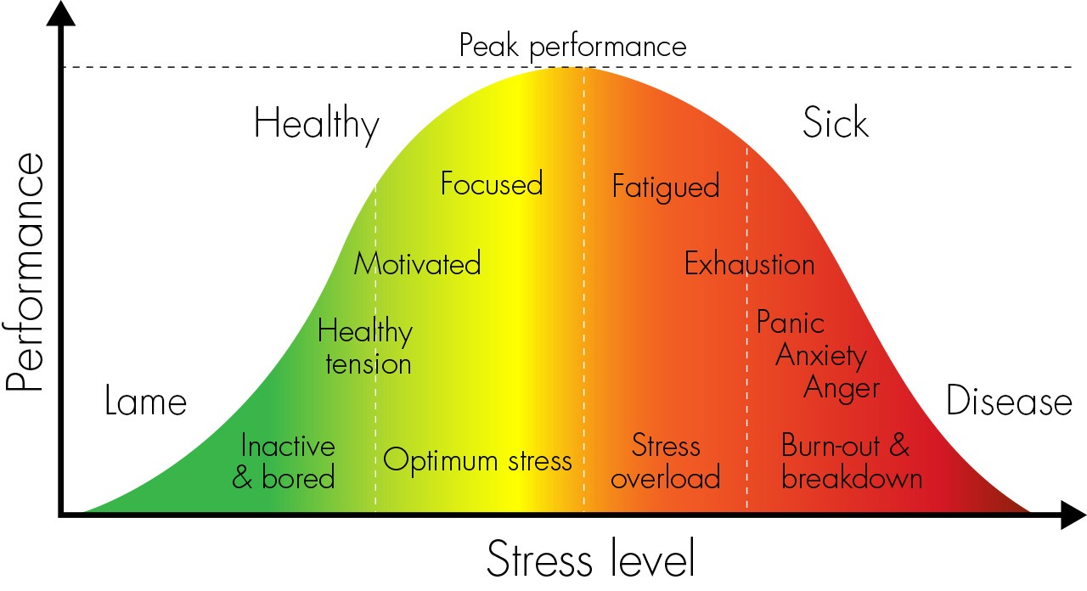
Yerkes-Dodson Inverted U

Slide 70
Stress Management..
Stress is mostly “in your head” – does all this stuff really matter that much, or perhaps not??
To reduce stress, become a Boulderite / Davisite:
Exercise
Meditation
Optimism
Sunshine, fresh air, etc..

Slide 71
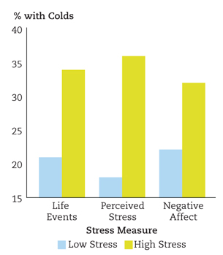
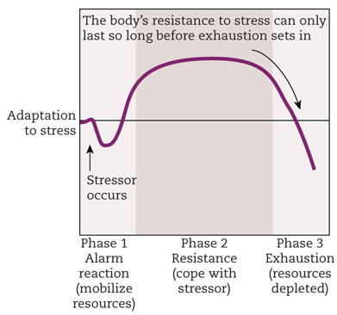
Stress THEN Sick
Stress itself does not make you sick..
It is the depletion period AFTER the stressor is over that makes you sick!

